Slide 1

Improving Text Extraction Accuracy with Image Preprocessing
Under the guidance of Dr. T. Sridevi
BE2102-07
1601 18 733 067
1601 18 733 081

Slide 2
Agenda
Problem Statement
Methodology
Architecture
Project Status
Code

Slide 3
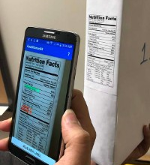
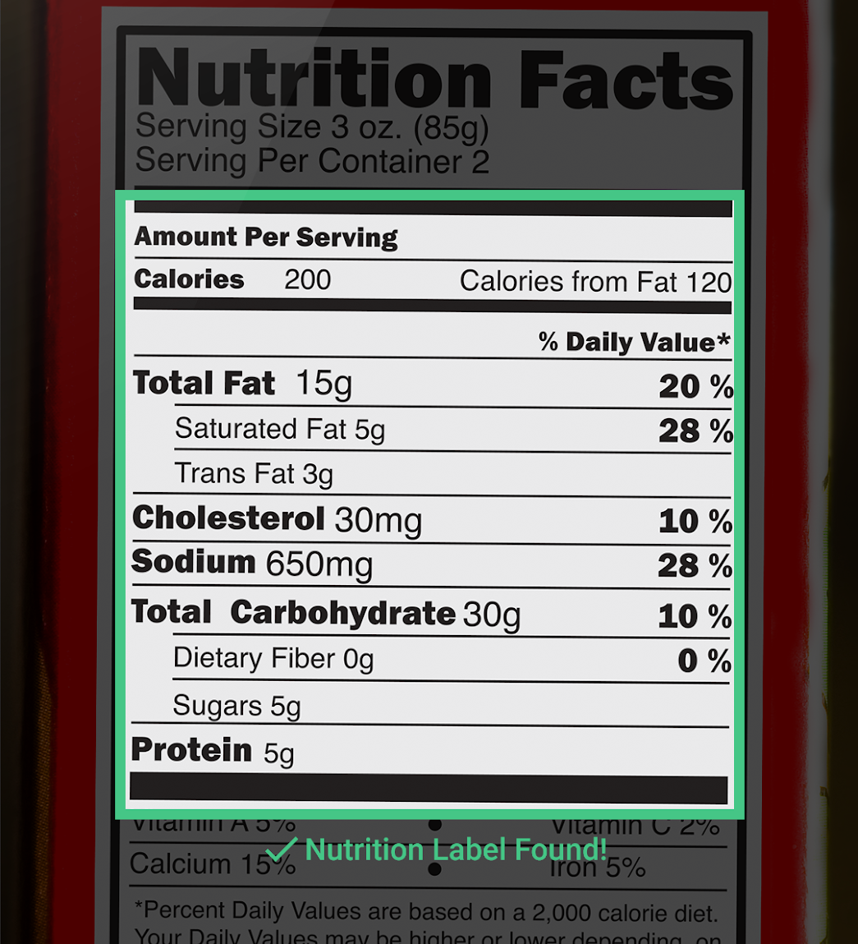
Advancements in computer vision have paved the way by providing tools for text detection and extraction. It’s been observed that the accuracy of the extracted text is relatively low and contains a lot of noise. The aim is to extend the current pipeline to improve the accuracy by
Improving the quality of the image
Using NLP to extract information from raw text

Slide 4
Methodology

Slide 5










Methodology
Scanned Image File Upload
Image Preprocessing Pipeline
Optical Character Recognition
Text Extraction
Information Extraction
Text - to - Speech Conversion
Document
Scan
Notes:
Preprocessing pipeline workflow
Speech to text

Slide 6
Architecture

Slide 7
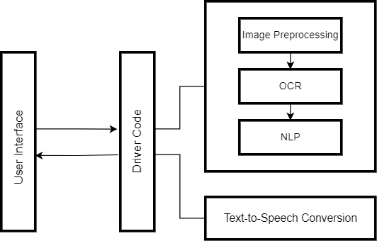
Architecture

Slide 8
Project Status

Slide 9
Current Status
Presented Review 1
Gained access to use college leave applications as dataset
Drafted survey paper
Developed code for image preprocessing pipeline
Developed code for text extraction using NLP

Slide 10
Next Steps
Develop code for converting text to speech
Test the software with varied images and maintain a log of defects
Deploy the software as an API
Document final result, findings and accomplishments to the Department.

Slide 11
Thank You

